Slide 1
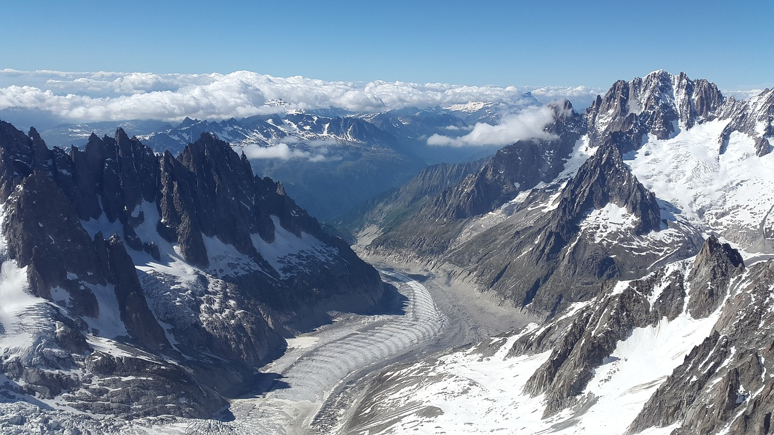
TIME SERIES FOR GLACIERS SURFACE MASS BALANCE AND WEATHER FORCASTING
JULIA LEÓN HERMIDA
IRONHACK
JULY 2021

Slide 2
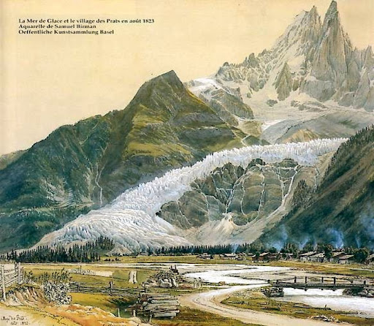
INITIAL PURPOSE
Time Series for Weather and Glaciers Surface Mass Balance Forcast

Slide 3
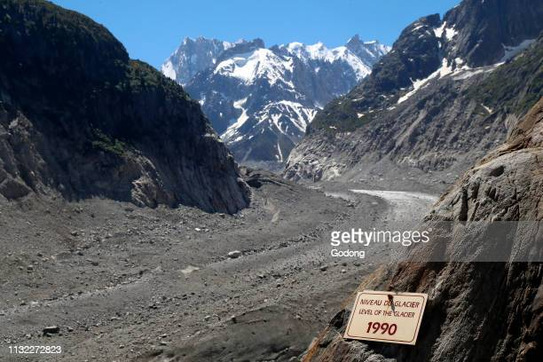
INITIAL PURPOSE
Time Series for Weather and Glaciers Surface Mass Balance Forcast

Slide 4
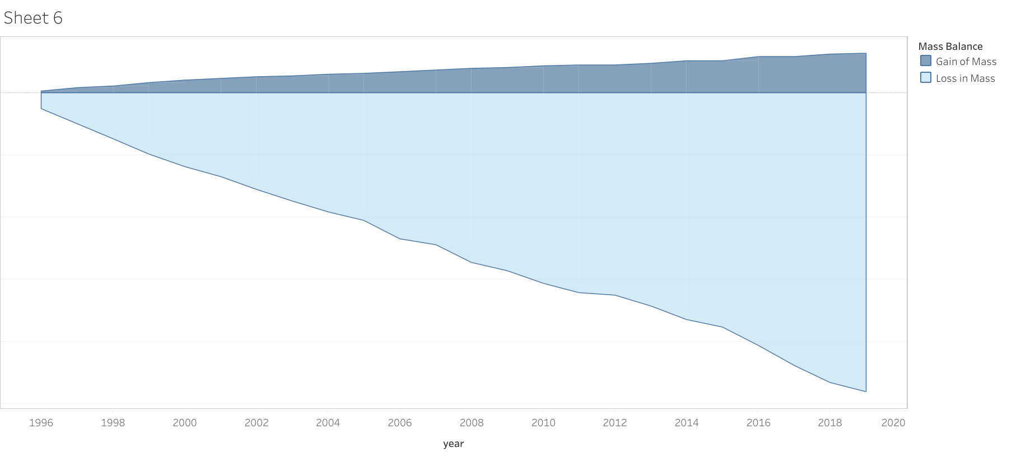
SMB CHANGE
Time Series for Weather and Glaciers Surface Mass Balance Forcast

Slide 5
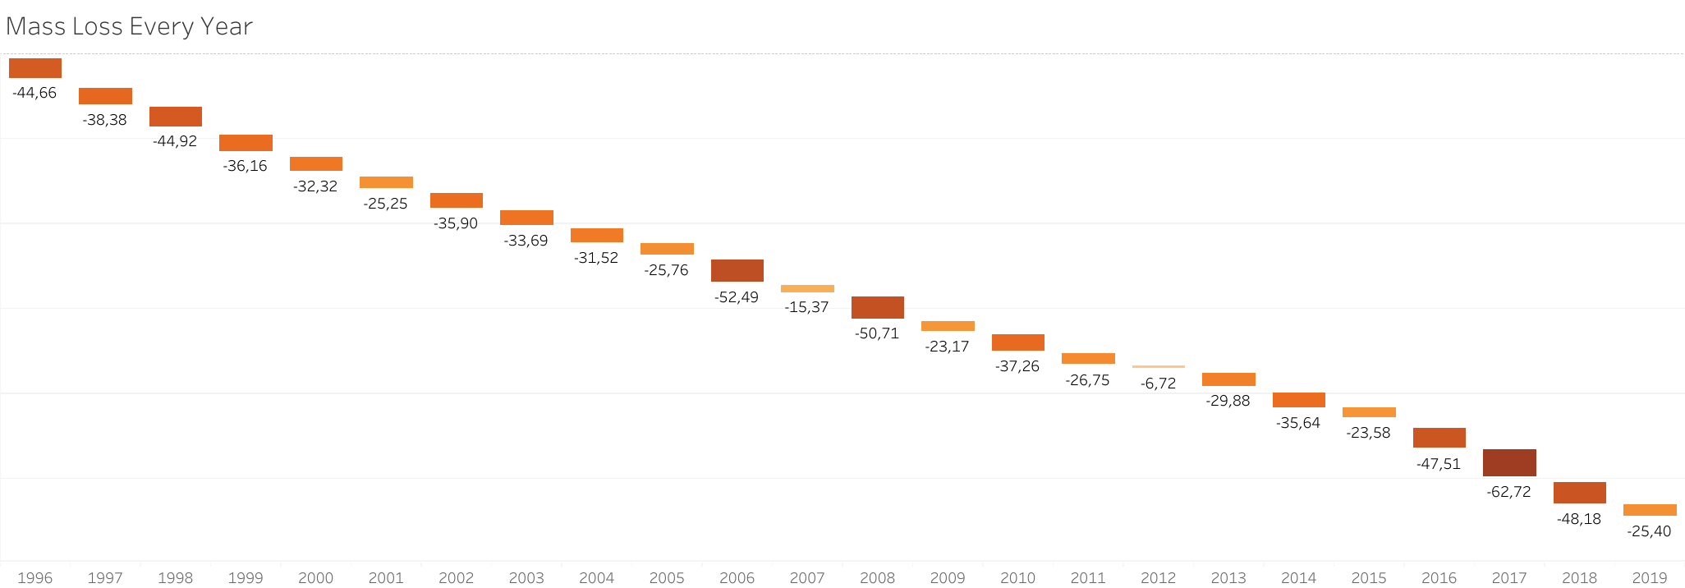
SMB CHANGE
Time Series for Weather and Glaciers Surface Mass Balance Forcast

Slide 6
TIME SERIES
HYPOTHESIS
USEFUL TO PREDICT THE FUTURE?
Time Series for Weather and Glaciers Surface Mass Balance Forcast

Slide 7
TIME SERIES
HYPOTHESIS
USEFUL TO PREDICT THE FUTURE?
ARIMA
Time Series for Weather and Glaciers Surface Mass Balance Forcast

Slide 8
MODEL’S LIMITATIONS
Time Series for Weather and Glaciers Surface Mass Balance Forcast

Slide 9
ONLY ONE PARAMETER PREDICTED AT ONCE NO TIME GAPS ACCEPTED TOO MANY ASSUMPTIONS VERY LOW ACCURACY
MODEL’S LIMITATIONS
Time Series for Weather and Glaciers Surface Mass Balance Forcast

Slide 10
ONLY ONE PARAMETER PREDICTED AT ONCE NO TIME GAPS ACCEPTED TOO MANY ASSUMPTIONS VERY LOW ACCURACY
MODEL’S LIMITATIONS
Time Series for Weather and Glaciers Surface Mass Balance Forcast

Slide 11
ONLY ONE PARAMETER PREDICTED AT ONCE NO TIME GAPS ACCEPTED TOO MANY ASSUMPTIONS VERY LOW ACCURACY
MODEL’S LIMITATIONS
Time Series for Weather and Glaciers Surface Mass Balance Forcast

Slide 12
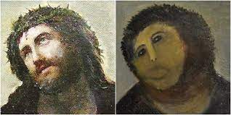
ONLY ONE PARAMETER PREDICTED AT ONCE NO TIME GAPS ACCEPTED TOO MANY ASSUMPTIONS VERY LOW ACCURACY
MODEL’S LIMITATIONS
Time Series for Weather and Glaciers Surface Mass Balance Forcast

Slide 13
UNDERSTANDING DATA DEALING WITH MISSING VALUES GATHERING DATAFRAMES
PROBLEMS PROCESSING DATA
Time Series for Weather and Glaciers Surface Mass Balance Forcast

Slide 14
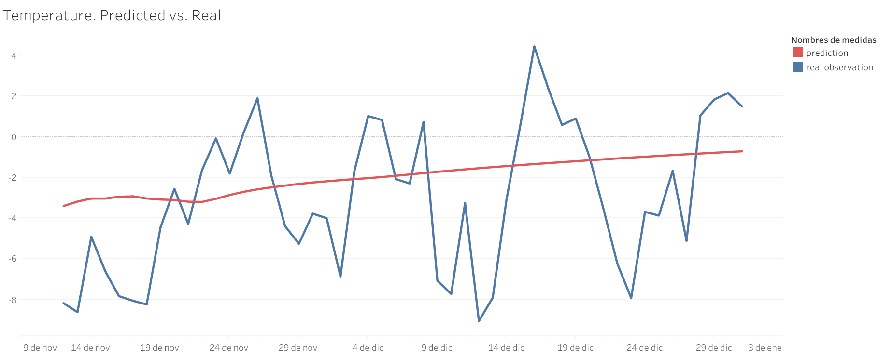
FORECAST RESULTS
2 weeks prediction with 12 years of daily information
Time Series for Weather and Glaciers Surface Mass Balance Forcast

Slide 15
CONCLUSIONS
ARIMA has no accuracy predicting
More complex models needed (Deep Learning)
Time Series for Weather and Glaciers Surface Mass Balance Forcast

Slide 16
LEARNINGS
Machine Learning Project Managment
Obtain Assess Data
Time Series Models
Deal with deadlines pressure
Reshape Project Targets
Ask for Help
Personal Growth
Time Series for Weather and Glaciers Surface Mass Balance Forcast

Slide 17

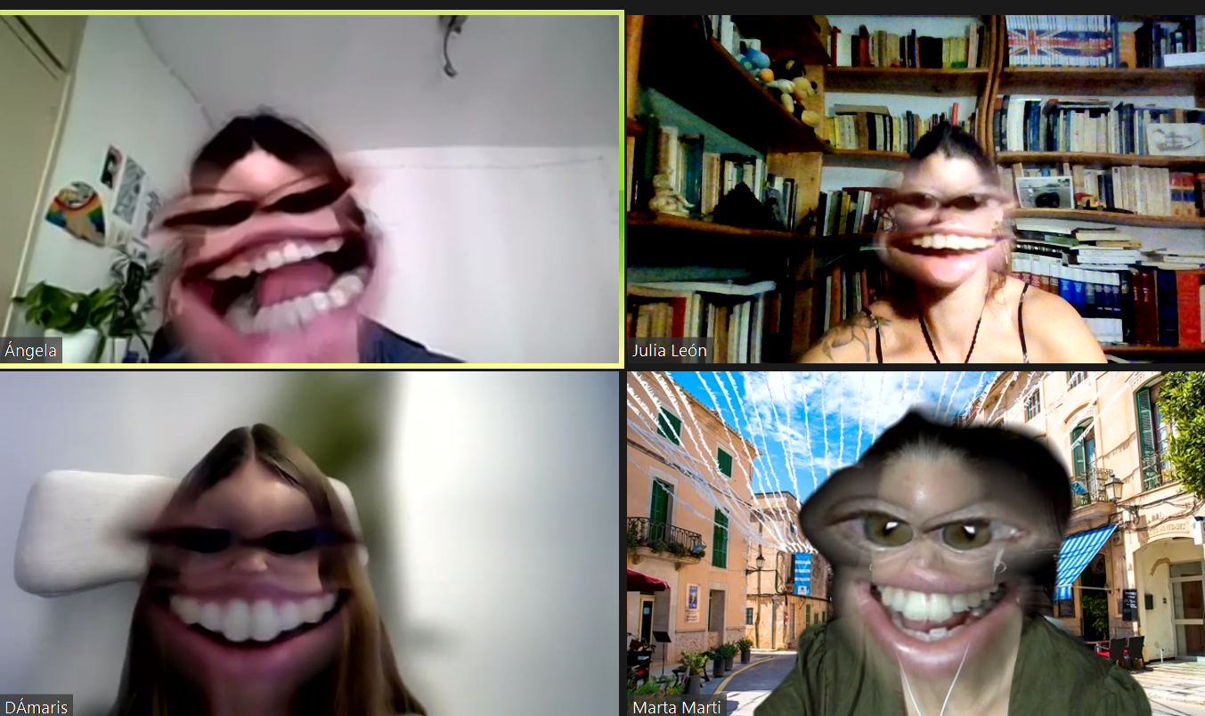



GREETINGS
GLACIOCLIM
TEACHING TEAM
CLASSMATES
Time Series for Weather and Glaciers Surface Mass Balance Forcast

